Slide 1

Transactions
Introduction

Slide 2
Transactions
Motivated by two independent requirements
Concurrent database access
Resilience to system failures
Notes:
Transactions are a very important concept. The concept of transactions is actually motivated by two completely independent concerns. One has to do with concurrent
access to the database by multiple clients and the other has to do with having a system that is resilient to system failures.
So we're going to talk about each of these in detail in turn.

Slide 3
Transactions
Concurrent Database Access
Even more software
Select…
Update…
Create Table…
Drop Index…
Help…
Delete…
More software
DBMS
Data
Notes:
Let's take a look at the software structure of how database systems are used. We have the data itself usually stored on disc. And then we have the database management
system, or DBMS, that controls interactions with the data. Often there's additional software above the DBMS, maybe an application server or web server. And then interacting with that might be a human user or additional software, and the types of operations that these users or the software will be issuing to the database are the things we’ve looked at such as select command and SQL or update commands, creating tables, creating and dropping indexes, maybe a help command, a delete command.
So each of the clients or the software applications will be issuing these types of commands for the database, and most importantly, they will be issuing them concurrently and we might have, you know, a database with one user, ten hundreds or even thousands of users at the same time.

Slide 4
Transactions
Concurrent Access: Attribute-level Inconsistency
Update University Set enrollment = enrollment + 1000
Where uName = ‘Comsats’
concurrent with …
Update University Set enrollment = enrollment + 1500
Where uName = ‘Comsats’
Notes:
Let's look at the kind of difficulties that we can get into when multiple clients are interacting with a database at the same time.
We'll be focusing mostly on SQL statements of modifications and some queries that are being issued by clients. And we'll look at some different levels where inconsistency can occur. We're going to focus our first example just on a single attribute and how it can have problems when multiple clients are working on the same attribute.
So let's say we have two clients, one is issuing a statement that’s increasing Comsats's enrollment by 1000. The second client, around the same time is issuing a statement that's increasing Comsats’s enrollment by 1500. So we have in the database our University table here. And somewhere in this University table we actually have Comsat’s enrollment. Now the way database systems work is when we are modifying a value in the database . Effectively, the system first gets the value, then it modifies the value, and then it puts the modified value back in the database.
So here's the value that we're working on.
So, client S1 will fetch the value, add one thousand to it, and put it back.
Client S2 will do something similar, but adding 1,500 instead.
Let's suppose Comsats starts out with an enrollment of 15,000 and these two statements are executed concurrently.
What are the final values that we might have?
Well, if one of them runs before the other completely, then it will add 2,500 and we will get 17,500. On the other hand if they really can interleave their get, modifies, and puts, then it is possible that we’ll instead only add a 1,000, because the 1,500 gets lost, or we could only add 1,500. So there are three possible final values if there’s interleaving of the operations that modify the value. Of course we are going to see that there are mechanisms in the database to avoid this, but I want to motivate the reason that we have to have those mechanisms.

Slide 5
Transactions
Concurrent Access: Tuple-level Inconsistency
Update Apply Set major = ‘CS’ Where sID = 123
concurrent with …
Update Apply Set decision = ‘Y’ Where sID = 123
Notes:
Now let's look at an example where the inconsistency actually occurs at the tuple level. Again, we're going to have two clients that are both issuing statements to the database that will have some conflicting behavior. In this case they're both modifying the apply record for the student with ID 123.
The first client is trying to change that apply record to have a major that see us. Well the second is modifying a different attribute of the same record, saying that the decision should be yes.
Now let's take a look at again, so we'll have our table here. And now, in this case, we're looking at an entire tuple. Let's say that this is student 123 and so we have say, the major in here and the decision in here. Now I've mentioned already that the databases tend to use a sort of get, modify, put, and we talked about that at the attribute level previously, but in fact the reality is that it does occur at the tuple level, in fact sometimes it occurs at the entire page or disc lock level.
So let's suppose that it occurs at least at the tuple level. So, again, we can see the same problem, then, when we have the two clients. Each will be performing a get, modify, put if they do it interleaved, then it’s possible that we will see both changes. Whoops, then it is possible that we'll see both changes. We'll correctly get the major reset and the decision reset but it’s also possible we'd only see one of the two changes and it could be either one. So again, we need some mechanism to insure that we have consistent updates to the database that would give us what we expect. In this case, we would probably expect both changes to be persistent in the database.

Slide 6
Transactions
Concurrent Access: Table-level Inconsistency
Update Apply Set decision = ‘Y’
Where sID In (Select sID From Student Where GPA > 3.9)
concurrent with …
Update Student Set GPA = (1.1) ∗ GPA Where sizeHS > 2500
Notes:
Now, let's go one step further and look at table level inconsistency. Again we have our two clients, and they're submitting statements to the database around the same time.
One of them is modifying the apply table and it's setting the decision for applications to YES for every student who's GPA is greater than 3.9.
The other statement, occurring at about the same time, is modifying the student table; we've decided to increase the GPA of every student who comes from a large high school. So here we have the apply table. We have the student table. We have the first client S1 working on the apply table, but the conditions in which apply tables are updated depend on probing the student table.
Meanwhile we have client S2 that's modifying the student table. So what happens in the apply table can depend on whether it occurs before or after or during the modifications of the student table. So you know, students would certainly prefer if their GPA is increased before the apply records are automatically accepted based on the GPA. So again, a notion of consistency here would be that we understand that either all the GPA's are modified first and then the acceptances are made or vice versa and we’ll again see mechanisms that will help us enforce that.

Slide 7
Transactions
Concurrent Access: Multi-statement inconsistency
Insert Into Archive
Select * From Apply Where decision = ‘N’;
Delete From Apply Where decision = ‘N’;
concurrent with …
Select Count(*) From Apply;
Select Count(*) From Archive;
Notes:
As a final example we'll consider clients that are interacting with multiple tables again. But in this case we also have multiple statements that are playing into the situation.
Specifically we'll see an example, where we will want a one statement to not occur concurrently even between the statements from another client. So let me just show you the example. So here again we have two clients. I’ll call them C1 and C2 now, since the first one has two statements. So what the first client is doing is moving records from the apply table to an archive table. Specifically, it looks in the apply table for records where the decision is no and it inserts those into an archive.
And then in a second statement, and this is really the only way to do it, it deletes those tuples from the apply relation. The second client just happens to want to count the number of tuples in the apply table and in the archive table.
So again we have the two tables that are... we’re concerned with, the apply table and the archive table and what the first client is doing, is it's moving some tuples from apply to archive, and then in a second statement deleting those tuples from apply.
Our second client-- I’ll put this one in red--is counting from the apply and then counting from the archive. Now if we want the second client to see sort of a consistent state of the database, where we don’t have records that are duplicated between apply and archive, then we will really want that second client to go either completely before, or completely after, the first client.

Slide 8
Transactions
Concurrency Goal
Execute sequence of SQL statements so they appear
to be running in isolation
Simple solution: execute them in isolation
But want to enable concurrency whenever safe to do so
Notes:
So after that long sequence of examples, I hope you get the feeling of what we're looking for in concurrency. We have multiple clients interacting with the database at the same time, and if they have true interleaving of the commands that they're executing on the database, often update commands but some select commands as well, then we may get inconsistent or unexpected behavior. So what we'd like to have overall is the ability for clients to execute statements against the database and not have to worry about what other clients are doing at the same time. Specifically, a little more generally, we like the class to be able to execute a sequence of SQL statements, so that the client can at least act like those statements are running in isolation.
Now there's one obvious solution to do this, right?
Why don't we just execute them in isolation? This database system can take its client requests and just do them one at a time with no concurrency.
On the other hand we really do want to enable concurrency whenever we can.
Database systems are geared towards providing the highest possible performance, we talked about that way in the introduction into the course.
And they typically do operate it in an environment where concurrency is possible. They may be working on a multi-processor system. They may be using even a multi-threaded system. And database systems, also as they access the database, tend to do a whole bunch of I/O so a system that provides asynchronous I/O can also run multiple things concurrently. It can do one thing while it's waiting for data to be fetched by another. So assuming that system supports concurrency, then we would like the database software to support it as well.
As a very simple example, let's suppose we have five clients that are operating on the database and each one of them is operating on a completely different part of
the database, and we certainly wouldn't want to force the to execute sequentially when they could execute in parallel without causing any inconsistency problems.

Slide 9
Transactions
Resilience to System Failures
Bulk Load
DBMS
Data
Notes:
Let's switch gears entirely now and talk about system failures. Again, we have our database system working with the data on disc, and let's suppose we just
happen to be in the process of bulk loading our database. Maybe bringing in a large amount of data from an external source, say a set of files, and right in the middle of that bulk load we have a system crash or a system failure. It could be a software failure, could be a hardware failure, could be as simple as the power going out.
So, if the database is, at that point, half loaded, so let's say half of this data has made its way to disc and the other half hasn't, what happens when the system comes back up? That leaves us in a rather unpleasant inconsistent state.

Slide 10
Transactions
Resilience to System Failures
Insert Into Archive
Select * From Apply Where decision = ‘N’;
Delete From Apply Where decision = ‘N’;
DBMS
Data
Notes:
Or maybe we're just executing some commands on an existing data, remember our example earlier, where we were moving tuples from an apply relation to an archive. So we have our relations here. We're in the process of moving some data and then once it's moved, we're going to delete the data that we moved, and then all of a sudden once again we have a crash or a failure of some type right in the middle of that move.
So what do we do now? When the system comes up, how do we know what was moved and what wasn't?

Slide 11
Transactions
Resilience to System Failures
Lots of updates
buffered in memory
DBMS
Data
Notes:
As a last example, let's just suppose we were performing a whole bunch of updates on the database. And as a reminder the way database systems perform updates is they
bring some data from the disc into the memory. They modify it in memory and then eventually they write it back to disc.
So let's suppose in the middle of that process again we have a system crash. That would again leave the database in an inconsistent state.

Slide 12
Transactions
System-Failure Goal
Guarantee all-or-nothing execution, regardless
of failures
DBMS
Data
Notes:
So our overall goal for dealing
with system failures is that when we want to do something on the database that needs to be done in an all or nothing fashion, we'd like to tell the system that we want to
guarantee all or nothing execution for that particular set of operations on the database regardless of failures that might occur during the execution.

Slide 13
Transactions
Solution for both concurrency and failures
A transaction is a sequence of one or more SQL
operations treated as a unit
Transactions appear to run in isolation
If the system fails, each transaction’s changes are
reflected either entirely or not at all
Transactions
Notes:
So we've talked about problems with concurrency, we've talked about problems with system failures, and interestingly the exact same mechanism can be used to deal with both of those issues, and that mechanism is not surprisingly transactions. So overall, a transaction is a sequence of one or more operations that are treated as a unit.
Specifically, each transaction appears to run in isolation, and furthermore, if the system fails, each transaction is either executed in its entirety or not all.

Slide 14
Transaction
It is a set of operations used to perform a logical unit of work
A transaction generally represent change in DB
Transactions access data using read and write operations.

Slide 15
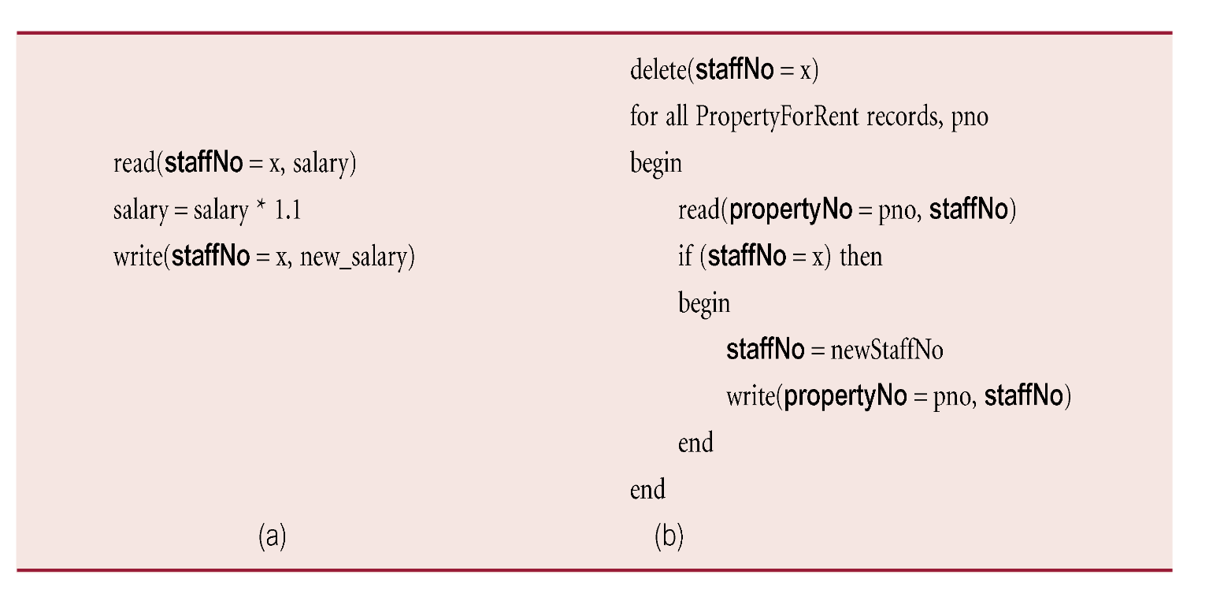
Example Transaction

Slide 16
Transaction Support
Can have one of two outcomes:
Success - transaction commits and database reaches a new consistent state.
Failure - transaction aborts, and database must be restored to consistent state before it started.
Such a transaction is rolled back or undone.
Committed transaction cannot be aborted.
Aborted transaction that is rolled back can be restarted later.

Slide 17
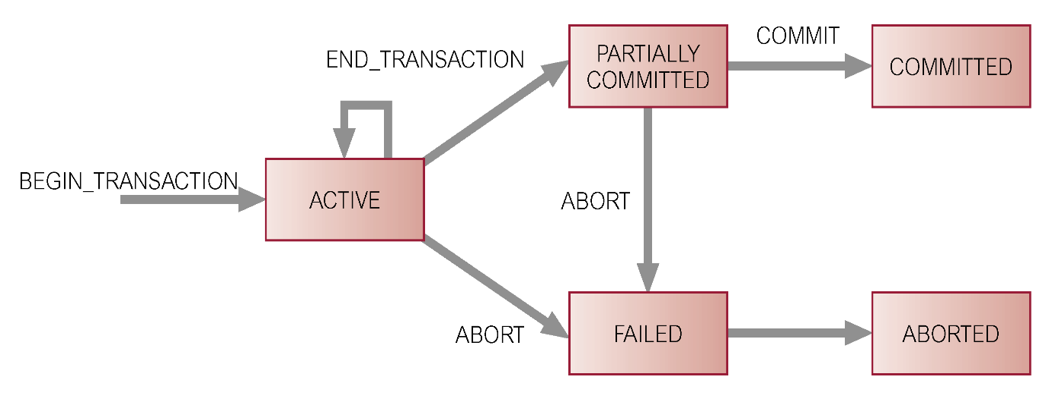
State Transition Diagram for Transaction

Slide 18
Transaction properties.
In order to maintain consistency in a database, before and after the transaction, certain properties are followed.
These are called ACID properties.

Slide 19
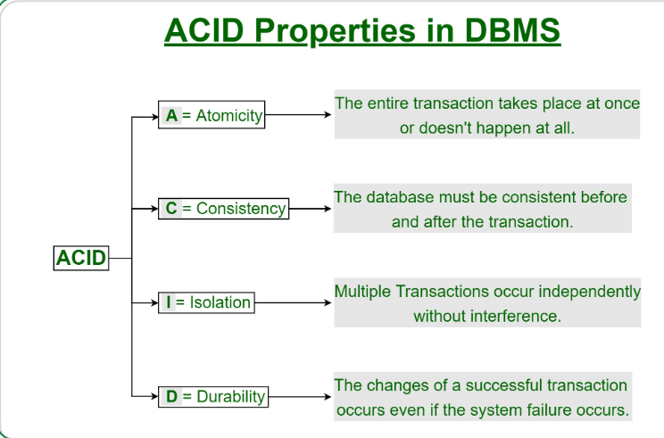

Slide 20
Properties of Transactions
Four basic (ACID) properties of a transaction are:
Atomicity ‘All or nothing’ property.
Consistency Must transform database from one consistent state to another.
Isolation Partial effects of incomplete transactions should not be visible to other transactions.
Durability Effects of a committed transaction are permanent and must not be lost because of later failure.

Slide 21
Transactions
(ACID Properties) Atomicity
Each transaction is
“all-or-nothing,”
never left half done
DBMS
Data

Slide 22
Transactions
Transaction Rollback (= Abort)
Undoes partial effects of transaction
Can be system- or client-initiated
Each transaction is
“all-or-nothing,”
never left half done
Begin Transaction;
<get input from user>
SQL commands based on input
<confirm results with user>
If ans=‘ok’ Then Commit; Else Rollback;

Slide 23
Transactions
(ACID Properties) Consistency
Each client, each transaction:
Can assume all constraints hold when
transaction begins
Must guarantee all constraints hold
when transaction ends
. . .
DBMS
Data

Slide 24
Transactions
(ACID Properties) Isolation
. . .
Serializability
Operations may be
interleaved, but execution
must be equivalent to some
sequential (serial) order
of all transactions
DBMS
Data

Slide 25
Transactions
(ACID Properties) Durability
If system crashes
after transaction commits,
all effects of transaction
remain in database
DBMS
Data

Slide 26
Concurrency Control
Process of managing simultaneous operations on the database without having them interfere with one another.
Prevents interference when two or more users are accessing database simultaneously and at least one is updating data.
Although two transactions may be correct in themselves, interleaving of operations may produce an incorrect result.

Slide 27
Need for Concurrency Control
Three examples of potential problems caused by concurrency:
Lost update problem.
Uncommitted dependency problem.
Inconsistent analysis problem.

Slide 28
Lost Update Problem
Successfully completed update is overridden by another user.
T₁ withdrawing £10 from an account with bal_{x}, initially £100.
T₂ depositing £100 into same account.
Serially, final balance would be £190.

Slide 29
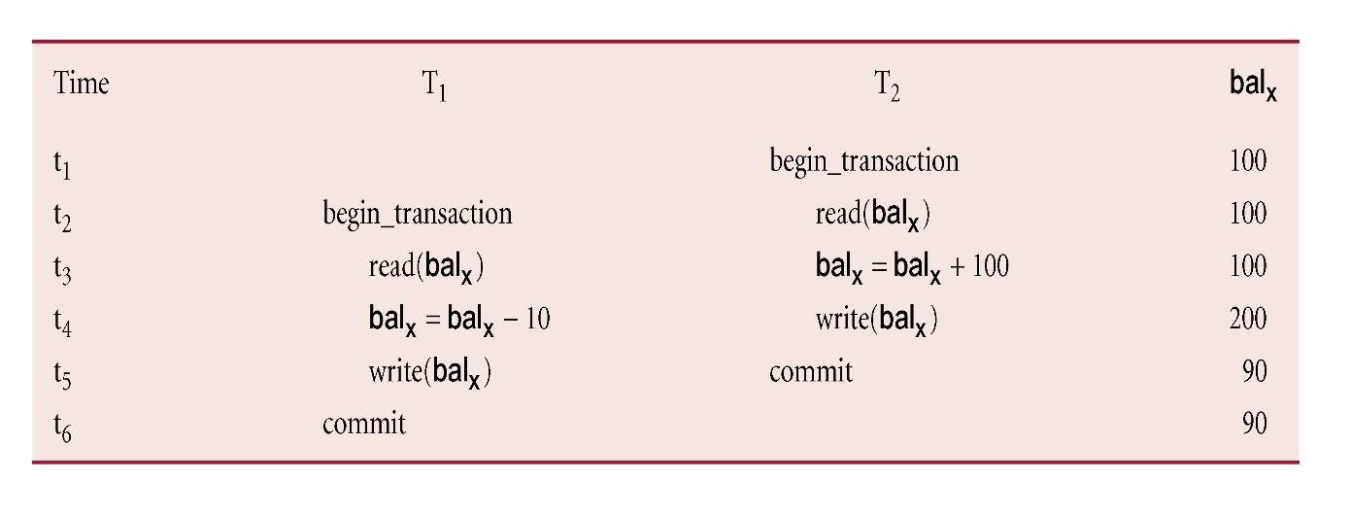
Lost Update Problem
Loss of T₂’s update avoided by preventing T₁ from reading bal_{x} until after update.

Slide 30
Uncommitted Dependency Problem
Occurs when one transaction can see intermediate results of another transaction before it has committed.
T₄ updates bal_{x} to £200 but it aborts, so bal_{x} should be back at original value of £100.
T₃ has read new value of bal_{x} (£200) and uses value as basis of £10 reduction, giving a new balance of £190, instead of £90.

Slide 31
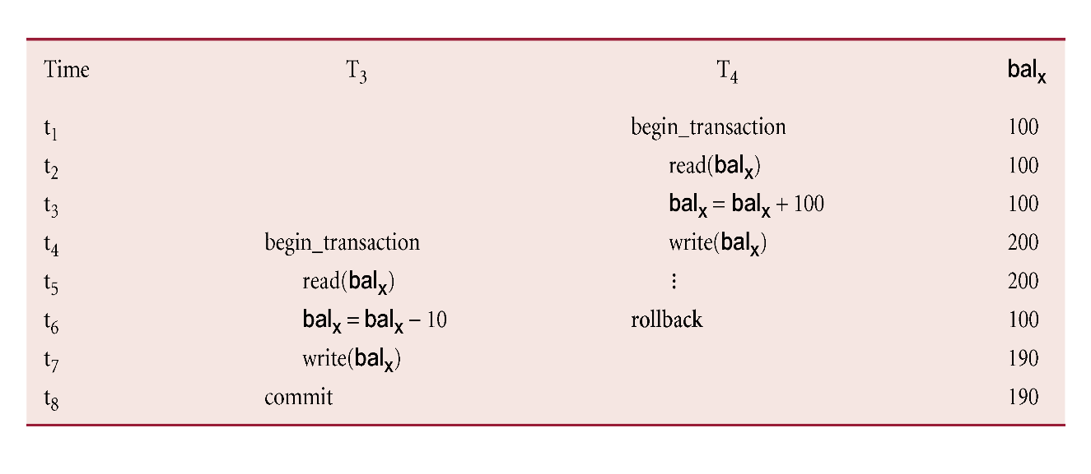
Uncommitted Dependency Problem
Problem avoided by preventing T₃ from reading bal_{x} until after T₄ commits or aborts.

Slide 32
Uncommitted Dependency Problem
Problem avoided by preventing T₃ from reading bal_{x} until after T₄ commits or aborts.

Slide 33
Inconsistent Analysis Problem
Occurs when transaction reads several values but second transaction updates some of them during execution of first.
Sometimes referred to as dirty read or unrepeatable read.
T₆ is totaling balances of account x (£100), account y (£50), and account z (£25).
Meantime, T₅ has transferred £10 from bal_{x} to bal_{z}, so T₆ now has wrong result (£10 too high).

Slide 34
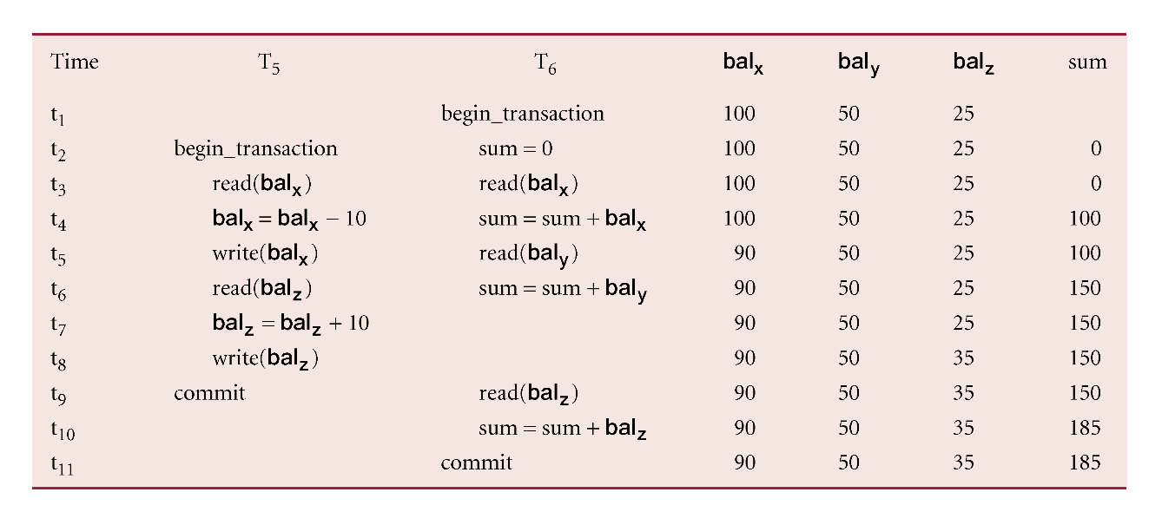
Inconsistent Analysis Problem
Problem avoided by preventing T₆ from reading bal_{x} and bal_{z} until after T₅ completed updates.

Slide 35
Serializability
Objective of a concurrency control protocol is to schedule transactions in such a way as to avoid any interference.
Could run transactions serially, but this limits degree of concurrency or parallelism in system.
Serializability identifies those executions of transactions guaranteed to ensure consistency.

Slide 36
Serializability
Schedule
Sequence of reads/writes by set of concurrent transactions.
Serial Schedule
Schedule where operations of each transaction are executed consecutively without any interleaved operations from other transactions.

Slide 37
Serializability
In serializability, ordering of read/writes is important:
(a) If two transactions only read a data item, they do not conflict, and order is not important.
(b) If two transactions either read or write completely separate data items, they do not conflict, and order is not important.
(c) If one transaction writes a data item and another reads or writes same data item, order of execution is important.

Slide 38
Serializability
T1 | T2
R(A)
W(A)
 | R(A) W(A)
T1 | T2
 | R(A)
 | W(A)
R(A)
W(A)

Slide 39
Serializability
S1
T1 T2
R(A)
R(A)
W(A)
W(A)
S2
T1 T2
R(A)
W(A)
R(A)
W(A)

Slide 40
Serializability
T1 T2 T3
FACTORIAL OF 3
L3=6

Slide 41
Nonserial Schedule
Schedule where operations from set of concurrent transactions are interleaved.
Objective of serializability is to find non serial schedules that allow transactions to execute concurrently without interfering with one another.
In other words, want to find non-serial schedules that are equivalent to some serial schedule. Such a schedule is called serializable.

Slide 42
Serializability
Conflict serializable schedule orders any conflicting operations in same way as some serial execution.
Under constrained write rule (transaction updates data item based on its old value, which is first read), use precedence graph to test for serializability.

Slide 43
Precedence Graph
Create:
node for each transaction;
a directed edge T_{i} → T_{j}, if T_{j} reads the value of an item written by T_{I};
a directed edge T_{i} → T_{j}, if T_{j} writes a value into an item after it has been read by T_{i}.
If precedence graph contains cycle schedule is not conflict serializable.

Slide 44
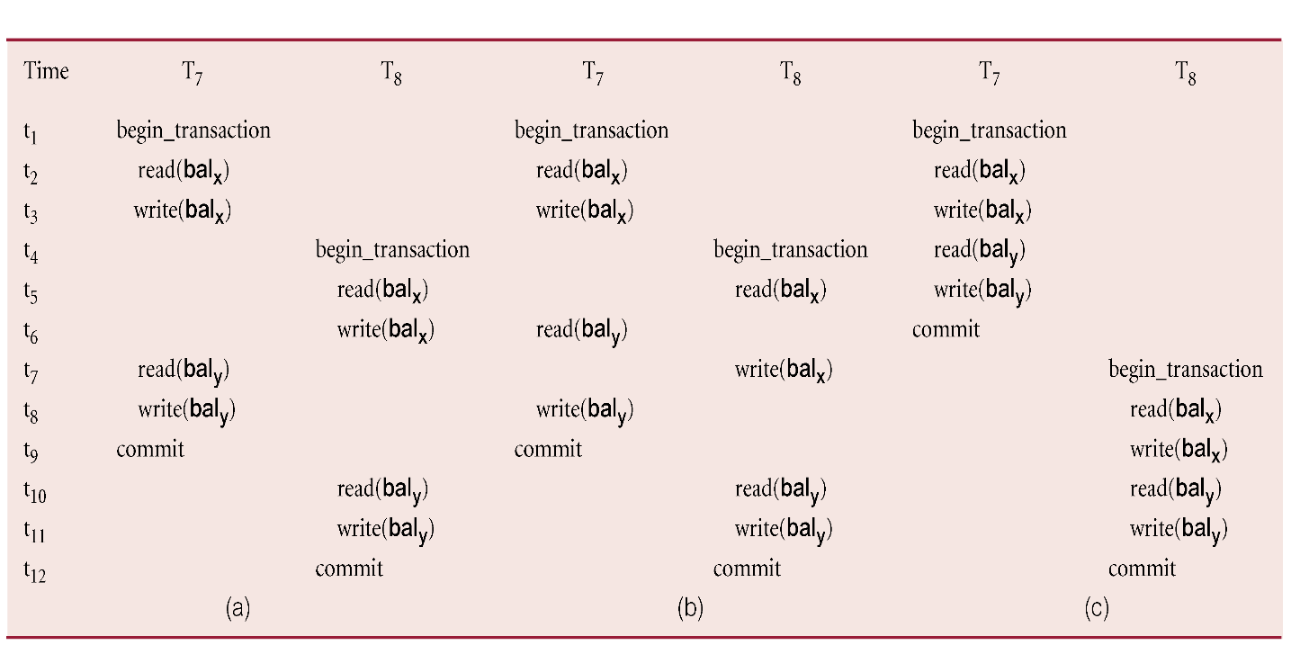
Example of Conflict Serializability

Slide 45
Conflict Serializable schedule
S1
T1 T2
R(A)
W(A)
R(A)
W(A)
W(B)
Note : Find Adjacent non-conflict pairs . Change their positions /swap their positions
When find conflict pairs then there would be no swapping.
S2
T1 T2
R(A)
W(A)
W(B)
R(A)
W(A)

Slide 46
Conflict Serializable schedule
T1 T2 T3
R(X)
R(Y)
R(X)
R(Y)
R(Z)
W(Y)
W(Z)
R(Z)
W(X)
W(Z)
Precedence Graph
If no cycle exist, then it is Conflict Serializable
Serial (consistent )
T2 T3 T1
Every conflict serializable schedule is view serializable, although converse is not true.
T1
T2
T3

Slide 47
Example - Non-conflict serializable schedule
T₉ is transferring £100 from one account with balance bal_{x} to another account with balance bal_{y}.
T₁₀ is increasing balance of these two accounts by 10%.
Precedence graph has a cycle and so is not serializable.

Slide 48
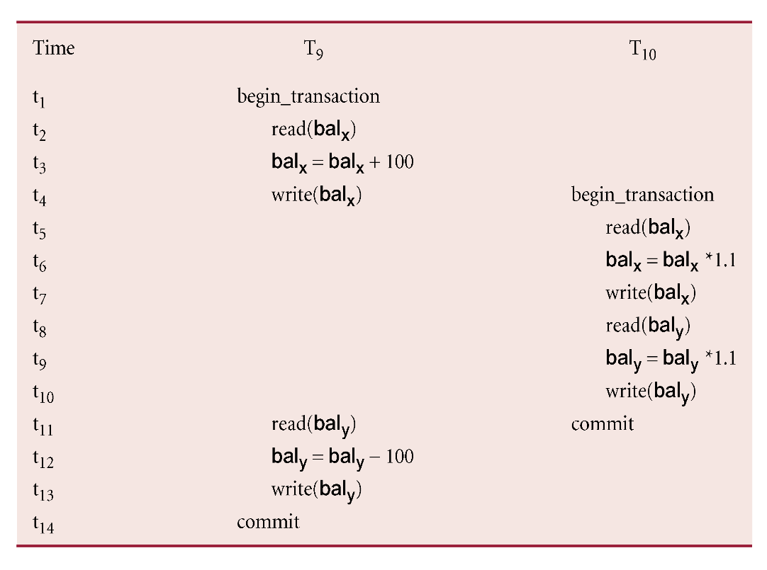
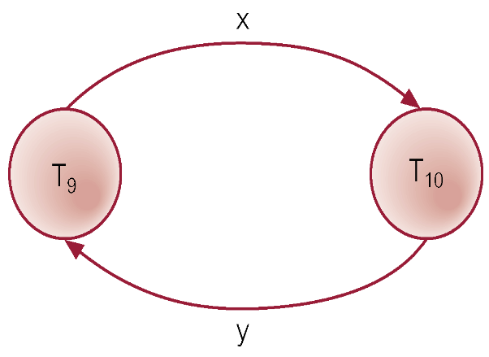
Example - Non-conflict serializable schedule

Slide 49

Non –conflict
T1 T2 T3
R(A)
W(A)
W(A)
W(A)
Precedence Graph
T1
T2
T3

Slide 50
View Serializability
Offers less stringent definition of schedule equivalence than conflict serializability.
Two schedules S₁ and S₂ are view equivalent if:
For each data item x, if T_{i} reads initial value of x in S₁, T_{i} must also read initial value of x in S₂.
For each read on x by T_{i} in S₁, if value read by x is written by T_{j}, T_{i} must also read value of x produced by T_{j} in S₂.
For each data item x, if last write on x performed by T_{i} in S₁, same transaction must perform final write on x in S₂.

Slide 51
View Serializability
Schedule is view serializable if it is view equivalent to a serial schedule.
Every conflict serializable schedule is view serializable, although converse is not true.
It can be shown that any view serializable schedule that is not conflict serializable contains one or more blind writes.
In general, testing whether schedule is serializable is NP-complete.

Slide 52
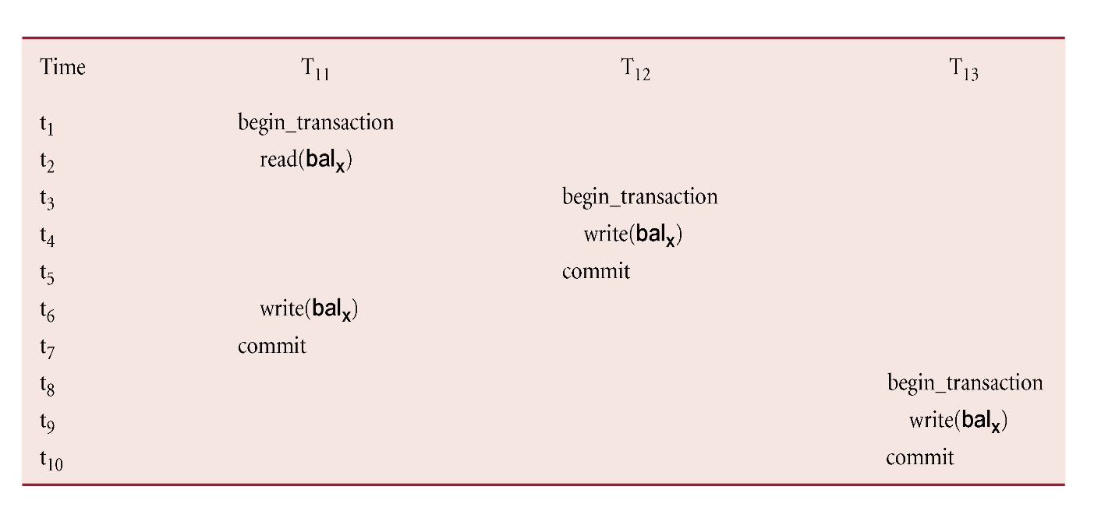
Example - View Serializable schedule

Slide 53
Isolation levels
Read uncommitted
Read committed
Repeatable read
Serializable

Slide 54
Violations
Dirty read
A transaction reads data written by other concurrent uncommitted transaction
Non- repeatable Read
A transaction reads same row twice and get different value because it has been modified by other committed Transaction
Phantom
A transaction re-execute a query to find rows that satisfy a condition and then again get different set of rows due to changes by other committed transactions

Slide 55
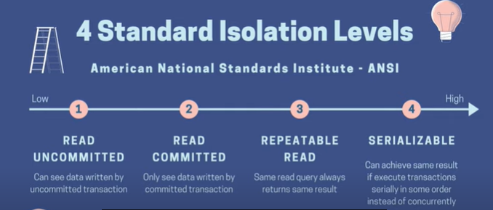
Isolation levels

Slide 56
Isolation levels /Violations
Isolation levels | Dirty Read | Non repeatable reads | Phantom
Read uncommitted | yes | Yes | Yes
Read committed | no | Yes | Yes
Repeatable Read | No | No | Yes
Serializable | No | No | No

Slide 57
Database Recovery
Process of restoring database to a correct state in the event of a failure.
Need for Recovery Control
Two types of storage: volatile (main memory) and nonvolatile.
Volatile storage does not survive system crashes.
Stable storage represents information that has been replicated in several nonvolatile storage media with independent failure modes.

Slide 58
Types of Failures
System crashes, resulting in loss of main memory.
Media failures, resulting in loss of parts of secondary storage.
Application software errors.
Natural physical disasters.
Carelessness or unintentional destruction of data or facilities.
Sabotage.

Slide 59
Transactions and Recovery
If transaction had not committed at failure time, recovery manager has to undo (rollback) any effects of that transaction for atomicity.
Partial undo - only one transaction has to be undone.
Global undo - all transactions have to be undone.

Slide 60
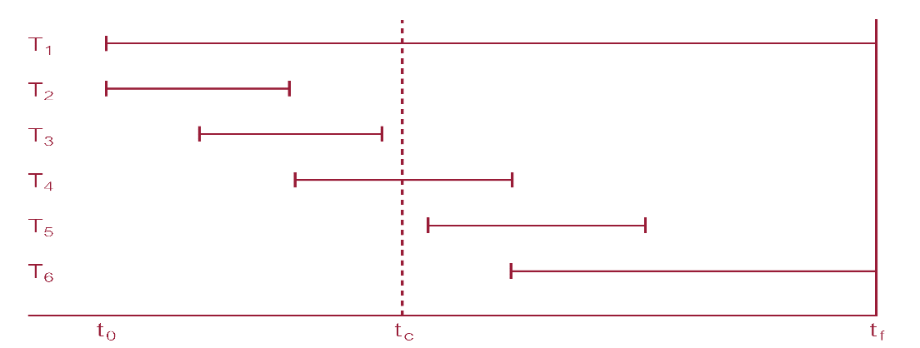
Example
DBMS starts at time t₀, but fails at time t_{f}. Assume data for transactions T₂ and T₃ have been written to secondary storage.
T₁ and T₆ have to be undone. In absence of any other information, recovery manager has to redo T₂, T₃, T₄, and T₅.

Slide 61
Recovery Facilities
DBMS should provide following facilities to assist with recovery:
Backup mechanism, which makes periodic backup copies of database.
Logging facilities, which keep track of current state of transactions and database changes.
Checkpoint facility, which enables updates to database in progress to be made permanent.
Recovery manager, which allows DBMS to restore database to consistent state following a failure.

